Slide 1

Lesson 2 CN4003:
Introduction to HTML and CSS
Dr Fadi Safieddine
1

Slide 2
Lecture Content:
Section one:
What is HTML?
Definition and history.
Getting started:
Application to start HTML.
Main structure.
Saving your work.
Facts about HTML Tags.
Overview of HTML Tags:
Paragraphs, Headings, Blockquote, Line Breaks, Text styles, Hyperlinks, and Images.
2

Slide 3

Lecture content
Section two:
What is CSS?
Advantages of CSS.
Review CSS Codes
How to link CSS to HTML
Several examples
Home work
Q&A
3

Slide 4

What is HTML?
HTML stands for:
HyperText Markup Language.
Using Tags and Attributes to design pages.
History:
HTML 4.0: Basic Web codes – published December 1997 by W3C.
XML 1.0: Allowing data storage on the page – published February - March 1998.
XHTML 1.1: HTML tags reformed in XML - Published May 2001.
HTML5: Allows integration of plug-in, animation, and other interface features – First publication January 2008 by W3C and more to come.
4

Slide 5
Getting Started:
You will need:
Most Text editor would allow you to work on creating your HTML pages: Notepad++, Editplus, Textmate, Dreamweaver, or any free package you can find. Modern browsers such as Firefox 3.5 +, IE9, chrome, and safari support.
There will be a link on Moodle to download Notepad++ for free.
https://notepad-plus-plus.org/downloads/
5

Slide 6

Installing Notepad++ at home

Slide 7
Getting Started:
Main Structure:
HTML5 declaration
<!doctype html>
<html >
<Head>……… </Head>
<Body> …… ……
</Body>
</html>
HTML opening tag
Heading info goes here
Body info goes here
HTML closing tag
7

Slide 8
Getting Started:
Overview:
<!doctype html>
<html lang="en">
<head> <Title>My First Test Page</Title>
</head>
<body>
Welcome to our very first page in HTML </body>
</html>
HTML declaration the page is in English.
8

Slide 9
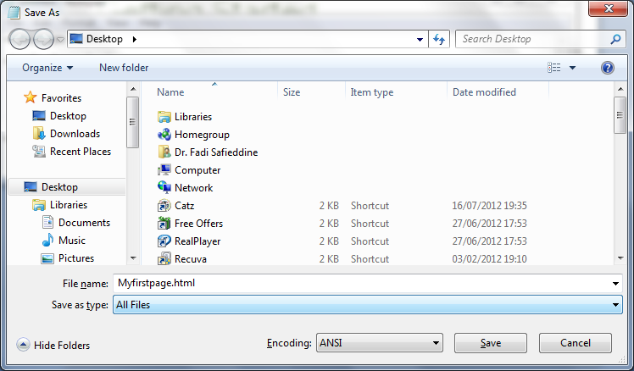
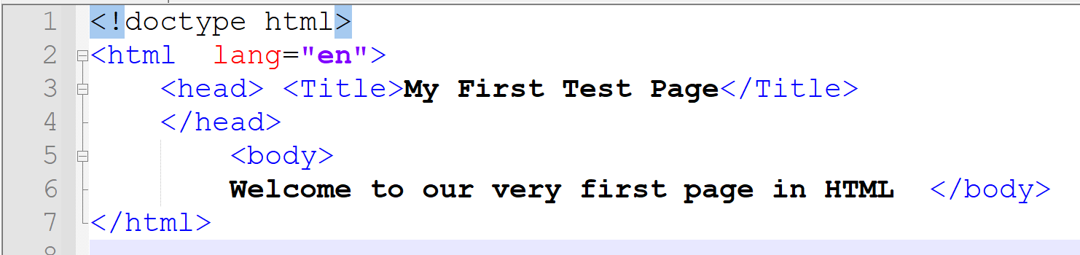
Getting Started:
Copy code into Notepad and Save document as HTML.
Make sure you select “All files”.
9

Slide 10
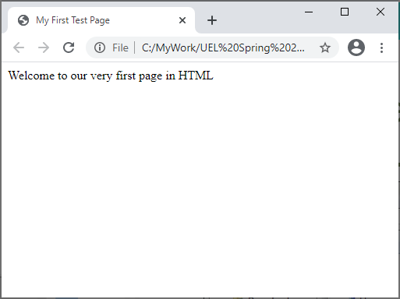
Getting Started:
Double click on the page you created or open it from a browser.
10

Slide 11
End of Part 1
Activity 2.1. Download Notepad++ on your computer and complete the set up.
Click the task box to indicate you completed this task.

Slide 12
HTML Tags:
Facts about HTML Tags:
They have opening Tags and closing Tags <P>...</P>
The words tend to be an abbreviation of what that tag is supposed to do.
Some tags have additional descriptions to specify their content. We call this Attributes.
Tags only deal with design and layouts. Later we learn about scripting that allows programming in HTML.
12

Slide 13
HTML Tags:
Part 2
13

Slide 14
Overview of HTML Tags:
Paragraph tag
<p> …… </p>
Groups sentences and sections of text together.
Can be used to create blank or spaces line above and below the paragraph
Can have an attribute to align the paragraph.
Example: <p align="right"> Hello </p>
Syntax: <p align="left|right|center|justify">...</p>
The alignment works only for HTML 4.01 in HTML 5 the alignment will be controlled from the CSS files.
14

Slide 15
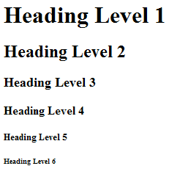
Overview of HTML Tags:
To create custom
Headings:
<h1>Heading Level 1</h1>
<h2>Heading Level 2</h2>
<h3>Heading Level 3</h3>
<h4>Heading Level 4</h4>
<h5>Heading Level 5</h5>
<h6>Heading Level 6</h6>
15

Slide 16
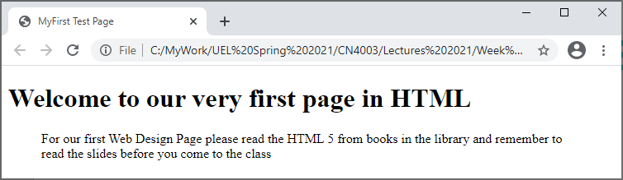
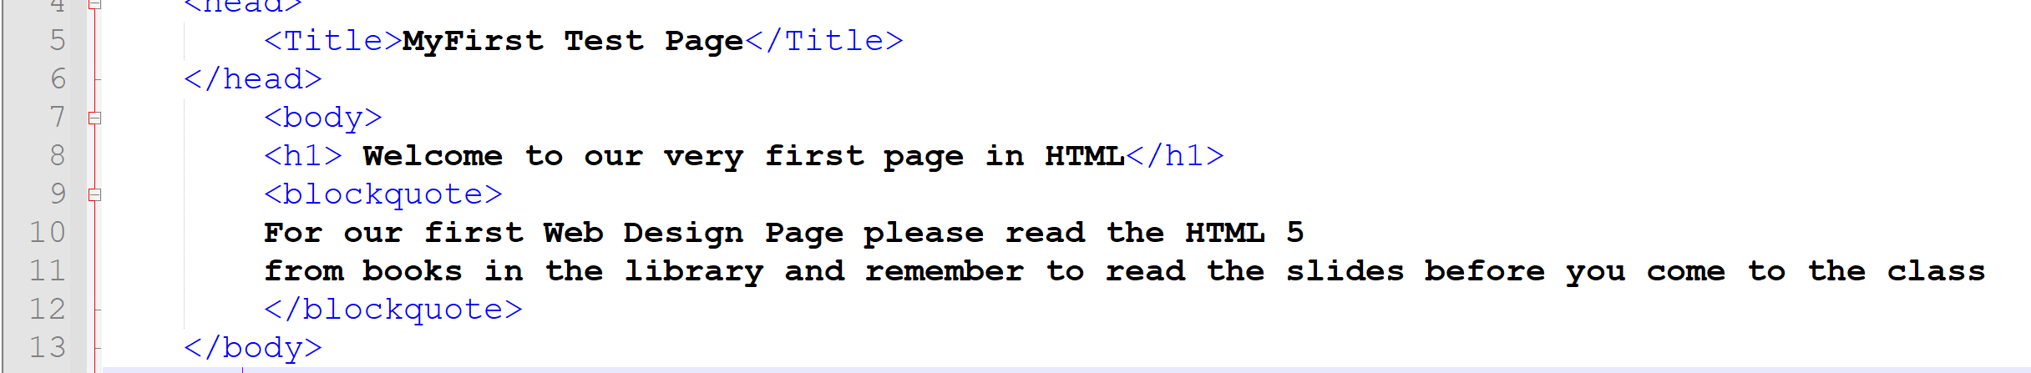
Overview of HTML Tags:
Blockquote Tag:
Indents a block of text for emphasis or better paragraph structure:
Syntax:
<blockquote>
…text here…
</blockquote>
Example:

Slide 17
Overview of HTML
Line Break Tag:
<BR>
Sometimes called Void.
One of few tags that do not need closing!
Makes the next element or text to show up on a new line.
Syntax: <br> This starts on a new line….
17

Slide 18
Overview of HTML Tags:
Text Style Tags: Bold / Italic / Underlined
BOLD: <strong></strong> Also <b></b>
To make the text go Bold. <strong> Our First Lesson </strong>
ITALIC: <em></em> also <i></i>
Make the text go slightly side ways
<em> HTML 5</em>
Underlined: <U> </U>
Underlines the text
<U> Read the lecture slides today </U>
18

Slide 19
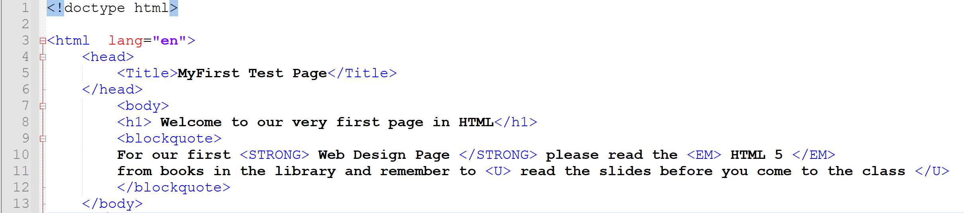
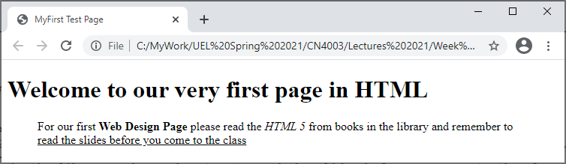
19

Slide 20

Overview of HTML Tags:
Creating a hyperlink in HTML:
HTML uses the <A>…</A> tag for Anchors (for links)
However this tag has an attribute to create the link. This attribute is HREF.
So to create a uel.ac.uk link on HTML page:
<A HREF = http://www.uel.ac.uk>…. </A>
In the empty dots you would write whatever text you find fit. For instance if we want people to ‘Click here’ to connect to UEL.
You can make the link open email instead by saying:
<A HREF = mailto:fadi@uel.ac.uk>…. </A>
20

Slide 21
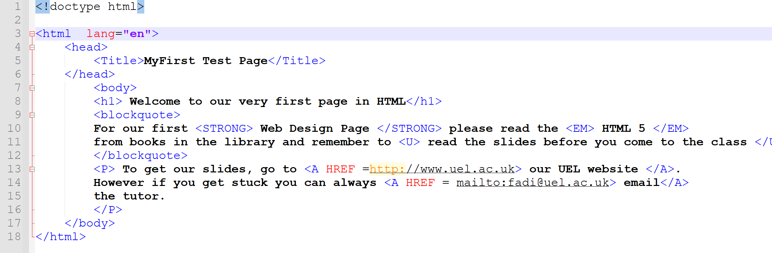
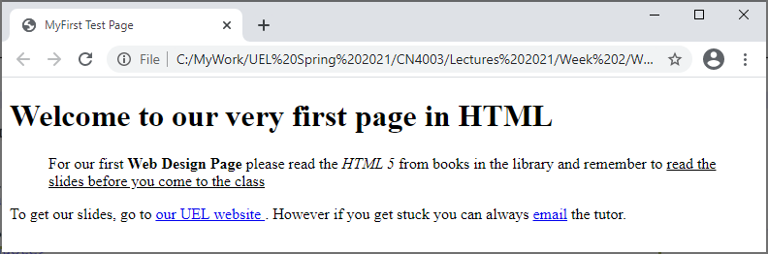
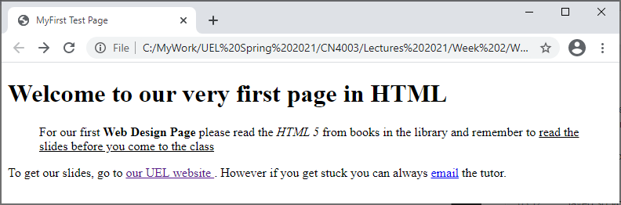
21

Slide 22
End of Part 2
Activity 2.2: What are the meanings of these tags and attributes:
<p>
<b>
<i>
<a>
<h2>
<br>
<blockquote>
<u>
HREF

Slide 23

Overview of HTML Tags:
Part 3
23

Slide 24
Overview of HTML Tags:
IMAGES:
Inserting a picture is bit challenging. Images are inserted using tag <IMG> and this tag has few interesting attributes:
SRC (Source) stating where the picture is located.
SRC = “Fadi2.jpg”.
This could also be on dedicated folder for images SRC = “/images/Fadi2.jpg”
NEVER EVER link it using directory address:
SRC = “C:/My Documents/Assignment/Images/Fadi2.jpg”
BORDER creating a border for image. BORDER = “1”*
HEIGHT & WIDTH used to state the height and width, if you want to state fixed size for image. The size is done in pixels. HEIGHT = “200” WIDTH = “200”
ALT for alternative text. It is the text the shows up when mouse is over the picture. ALT = “Fadi image”.
Example:
<IMG SRC="fadi2.jpg", border="1", Height="150", Width="125", Alt="Tutor's image">
*Please note under HTML5 border size will no longer be supported under HTML5 from the Image tag as it will be controlled by the CSS File.
24

Slide 25
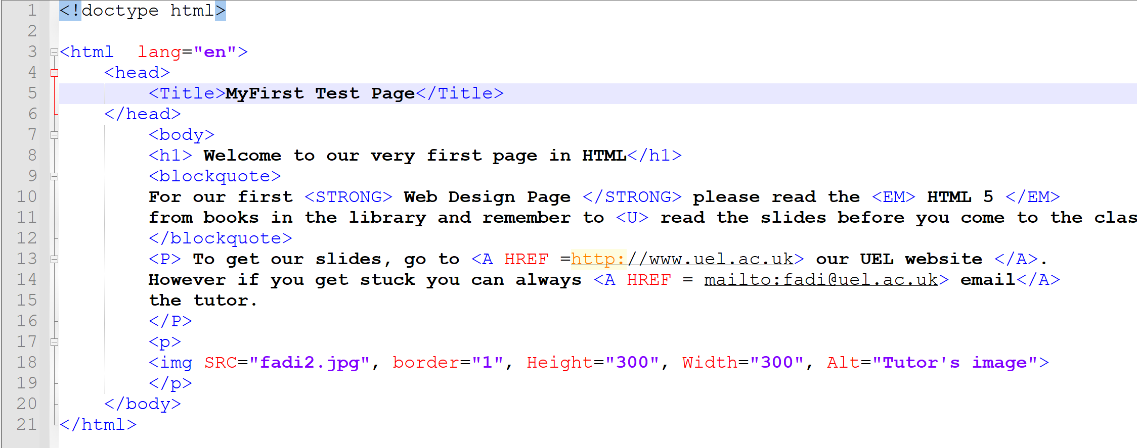
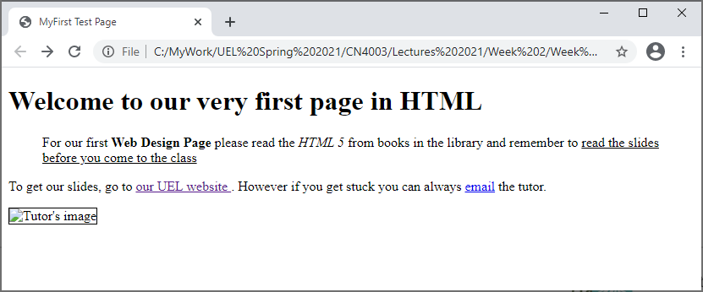
25

Slide 26
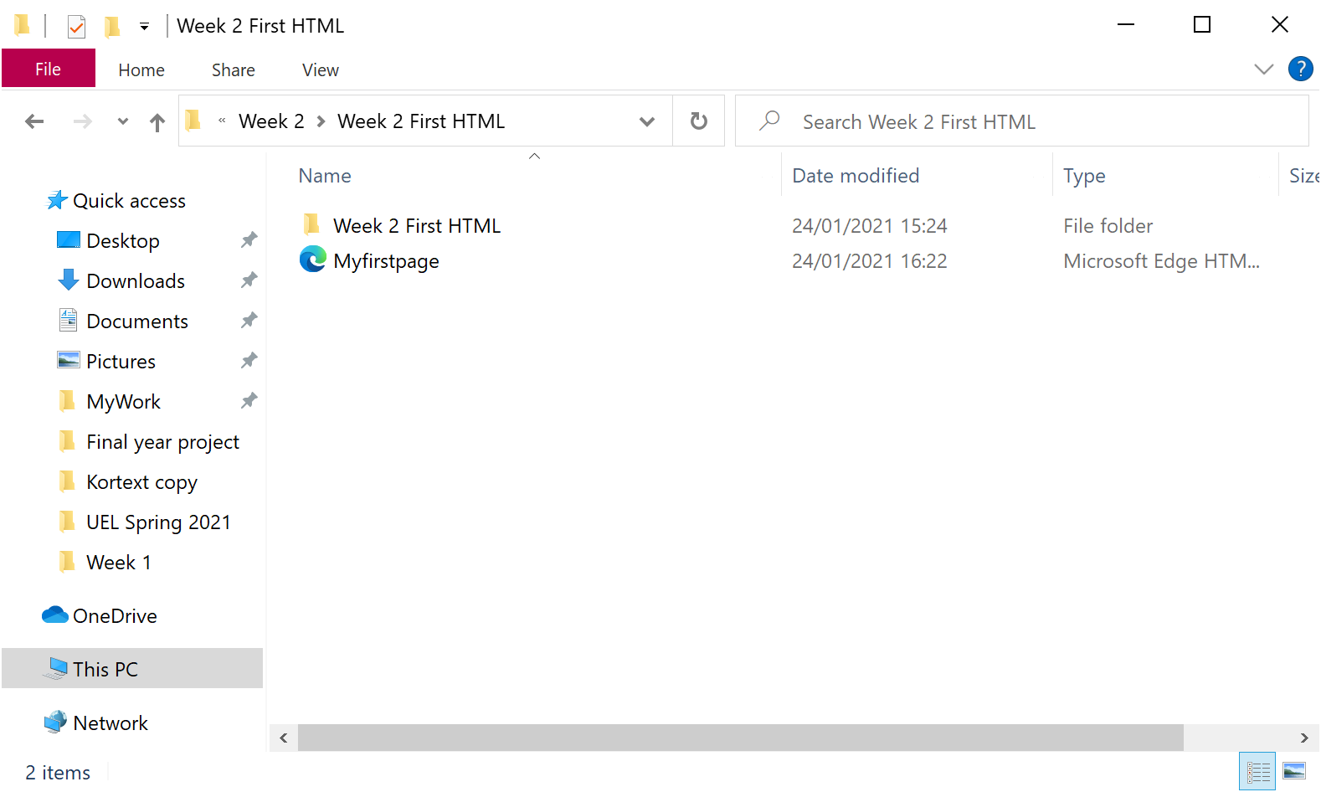
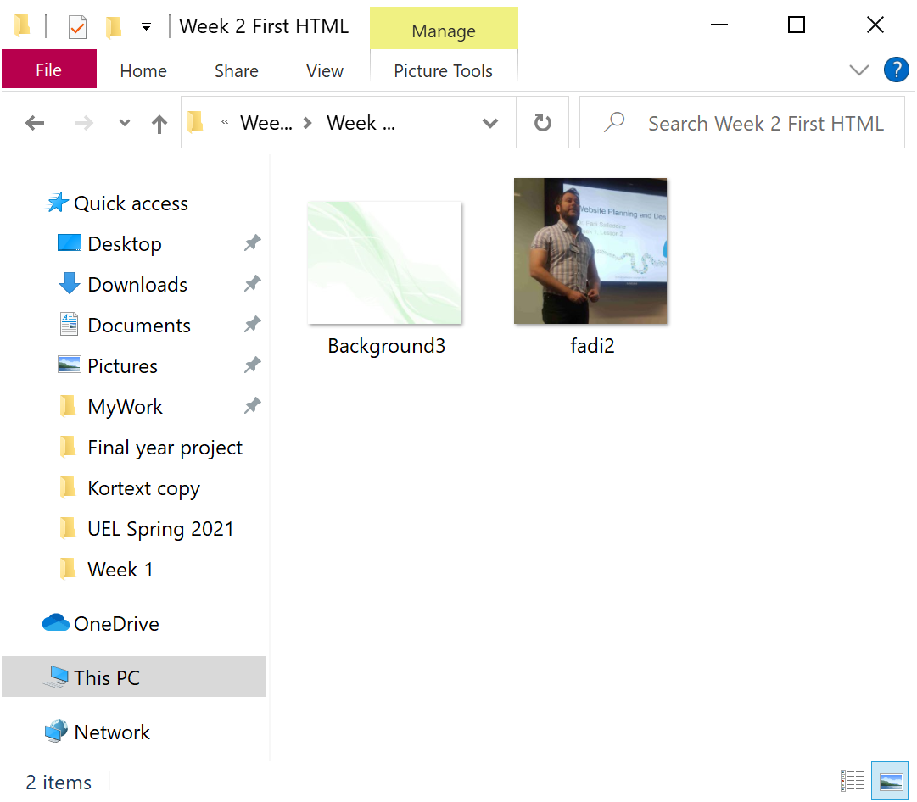
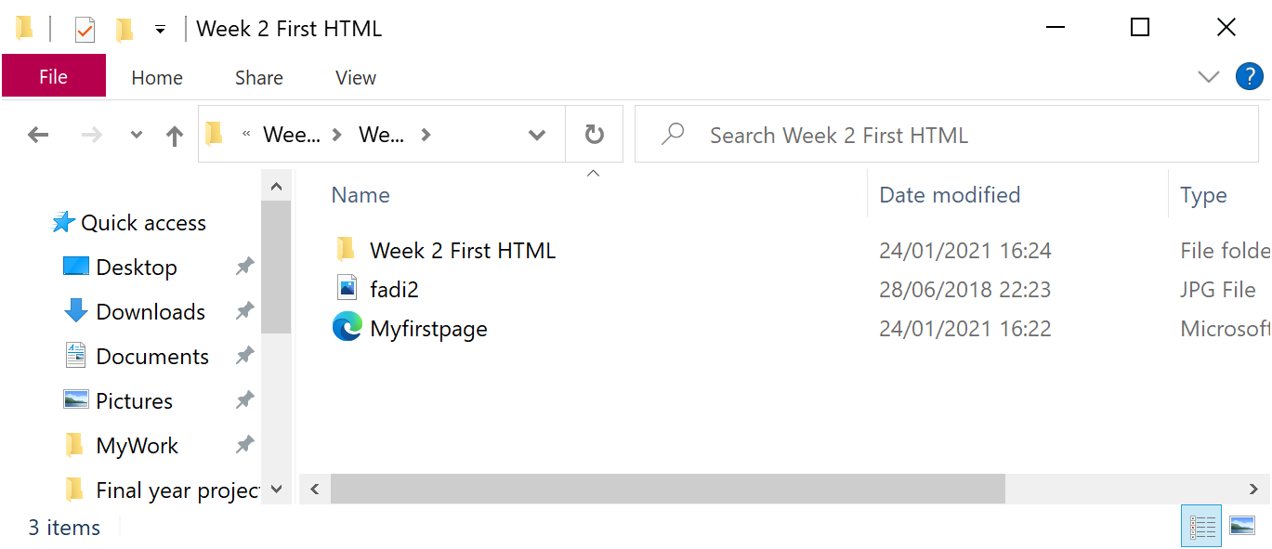

Slide 27
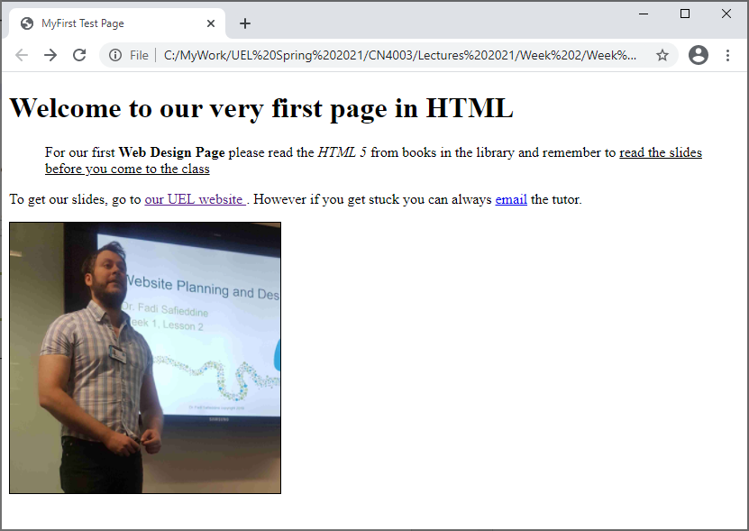
27

Slide 28
End of Part 3
Activity 2.3. Edit the following <IMG> codes to reflect the location of the image which has SRC=“MyPic.JPG”.
Image is inside folder called ‘Images’ which is on the same folder as your HTML page.
Image is on the same folder.
Image is on inside folder called ‘Pictures’ which is on the same folder as your HTML page.
Image is in a different folder on the C drive ‘C:/This PC/Pictures’.

Slide 29
Section 2:
Part 4
What about:
Background? Text formatting such as Font, colours, and alignments? Headings? And others?
We will learn these in the next section.
29

Slide 30

What is CSS?
Stands for Cascading Style Sheets.
Created by Hakon Wium Lie of MIT in 1994.
It is a separate .CSS file shared through linking by other HTML files.
Is a W3C standard for presentation design of a web page.
You get to maintain consistency in the design by having all the design on one page.
30

Slide 31
What is CSS?
CSS File
HomePage.html
Products.html
Services.html
AboutUs.html
Contactus.html
31

Slide 32
Advantages of CSS
Production of pages:
Downloads faster.
Improves consistency.
Speeds maintenance:
Global control of design attributes
Better control:
Positioning
Consistent layouts
Better Search Rankings
Cleaner code improves indexing by search engines.
32

Slide 33
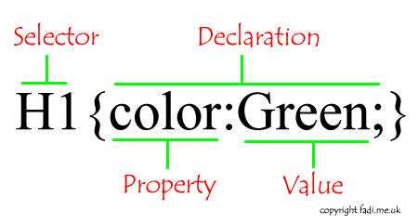
Review of CSS Codes:
Syntax Structure
33

Slide 34
Review of CSS codes:
CSS Selectors – (referred in HTML as tags)
H1 {color: red;}
P {color: blue;}
Body {background-color: RED;}
Let’s see these tags and more in details.
34

Slide 35
Review of CSS Codes
We will look at today:
Background
Font Control:
Paragraph
Headings & others
Hyperlinks
All of these can be controlled by the CSS.
And it makes no difference were they are placed, they are written in the same way.
Comments in CSS & HTML
35

Slide 36

More Review of CSS Code
Background:
Enhances the design of the page.
Body
But also can be used for other elements that can have backgrounds:
Paragraph, Images, Headings, and others.
There are many effects that maybe desired:
background-color
background-image
background-repeat
Lets see them in an examples.
36

Slide 37
More Review of CSS Code
Example:
background-color
h1 {background-color: RED;}
background-image
body {background-image:url(‘Background3.jpg');}
background-repeat
body{background-image:url(‘Background3.jpg'); background-repeat:no-repeat;}
37

Slide 38

Review of CSS Code
Fonts:
Fonts style, colors, size can all be controlled from most tags that control text:
Paragraphs, Headings(1-6), Blockquote..etc.
Style: p {font-family:"Arial";}
“New Times Roman”, “Serif”, and more.
Size: p {font-size:14px;}
Weight: p {font-weight:bold;}
Color: p {color:red;}
Of course you can have more than one declaration at the same time. Separate them by “;”
P {font-family:"Arial"; font-size:14px;color:blue;}
38

Slide 39

Review of CSS Code
Hyperlinks:
Hyper links can have several states:
a:link - A normal, unvisited link
a:visited - A link the user has visited
a:hover - When the mouse is over it
a:active - The moment it is clicked
Example:
a:link {color:green;}
a:visited {color:yellow;}
a:hover {color:red;}
a:active {color:blue;}
39

Slide 40

Review of CSS codes:
Writing comments in HTML and CSS.
It is good practice, it helps anyone reading your code to read your comments.
Ignored by the browsers.
HTML : <!-- This is a demo page -->
CSS: /* This will colour my links yellow */
40

Slide 41
End of Part 4
Activity 2.4. Explain this CSS code:
h1 {background-color:Yellow; text-align:left;}
p {font-family:'Arial'; font-size:12px;color:green;}
a:link {color:blue;}
a:visited {color:green;}

Slide 42
How to use CSS and HTML?
Part 5
42

Slide 43
How to use CSS and HTML?
Part 5
There are three ways:
External style sheet:
Complete separation of design from content.
Keeps all the styles on an external document.
Embedded style:
Specify style at start of the document.
Would override styles of an external document.
Inline style:
Specify style inside the document at code lines.
Would override styles of external document and the embedded style.
43

Slide 44
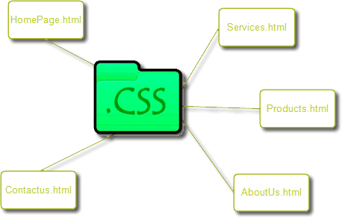
How to link HTML to CSS?
1. External Style Sheet
<!Doctype HTML>
<HTML>
<HEAD>
<LINK REL=“stylesheet” TYPE=“text/css” HREF=“styles/mystyles.css”/>
</HEAD>
<Body>
<H1> The style of this heading is determined by the style set in mystyle.css file </H1>
</Body>
</HTML>
44

Slide 45
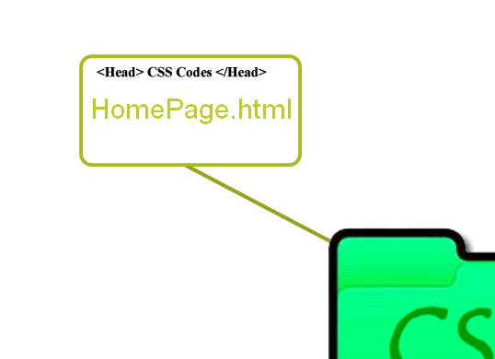
How to link HTML to CSS?
2. Embedded Style Sheets: Overrides the CSS
external file.
<!Doctype HTML>
<HTML>
<HEAD>
<TITLE>Embedded CSS</TITLE>
<STYLE TYPE=“text/css”>
H1 {color: green;}
P {font-size: 14pt; color: blue;}
</STYLE>
</HEAD>
<Body>
<H1> Welcome to Web Design with Embedded CSS </H1>
<P> Did you expect the text to be 12pt and black? </P>
</Body>
</HTML>
45

Slide 46
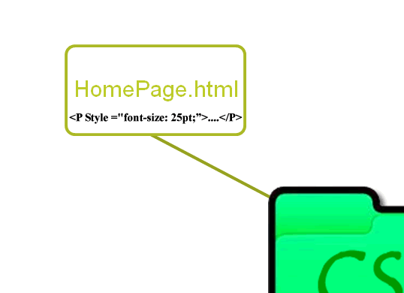
Implementing the design:
3. Inline Style: Writing the design style directly overriding CSS Style sheets or Embedded Style codes.
<!Doctype HTML>
<HTML>
<Head>
<Title> I am independent page! </Title>
</Head>
<Body>
<H1 STYLE=“color: green; font-size: 25px;”>A large Green Heading</H1>
</Body>
</HTML>
46

Slide 47
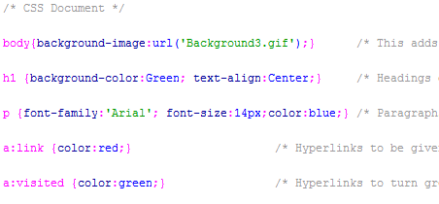
Creating CSS file
Open Notepad++ and type the settings below:
body{background-image:url('Background3.gif');}
h1 {background-color:Green; text-align:Center;}
p {font-family:'Arial'; font-size:14px;color:blue;}
a:link {color:red;}
a:visited {color:green;}
Save as textstyle.CSS file Now open your HTML page and link it in the Head tag.
<link rel="stylesheet" type="text/css“ href=“textstyle.css" />
47

Slide 48
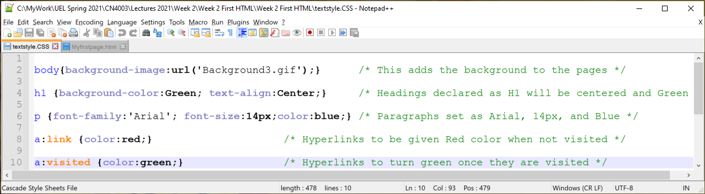
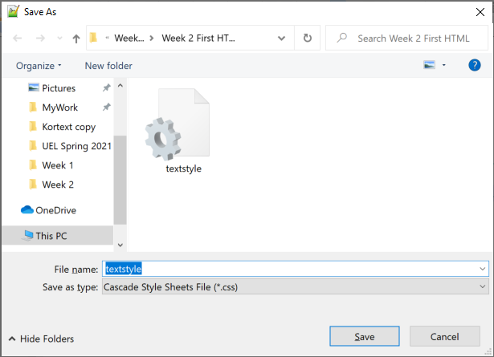
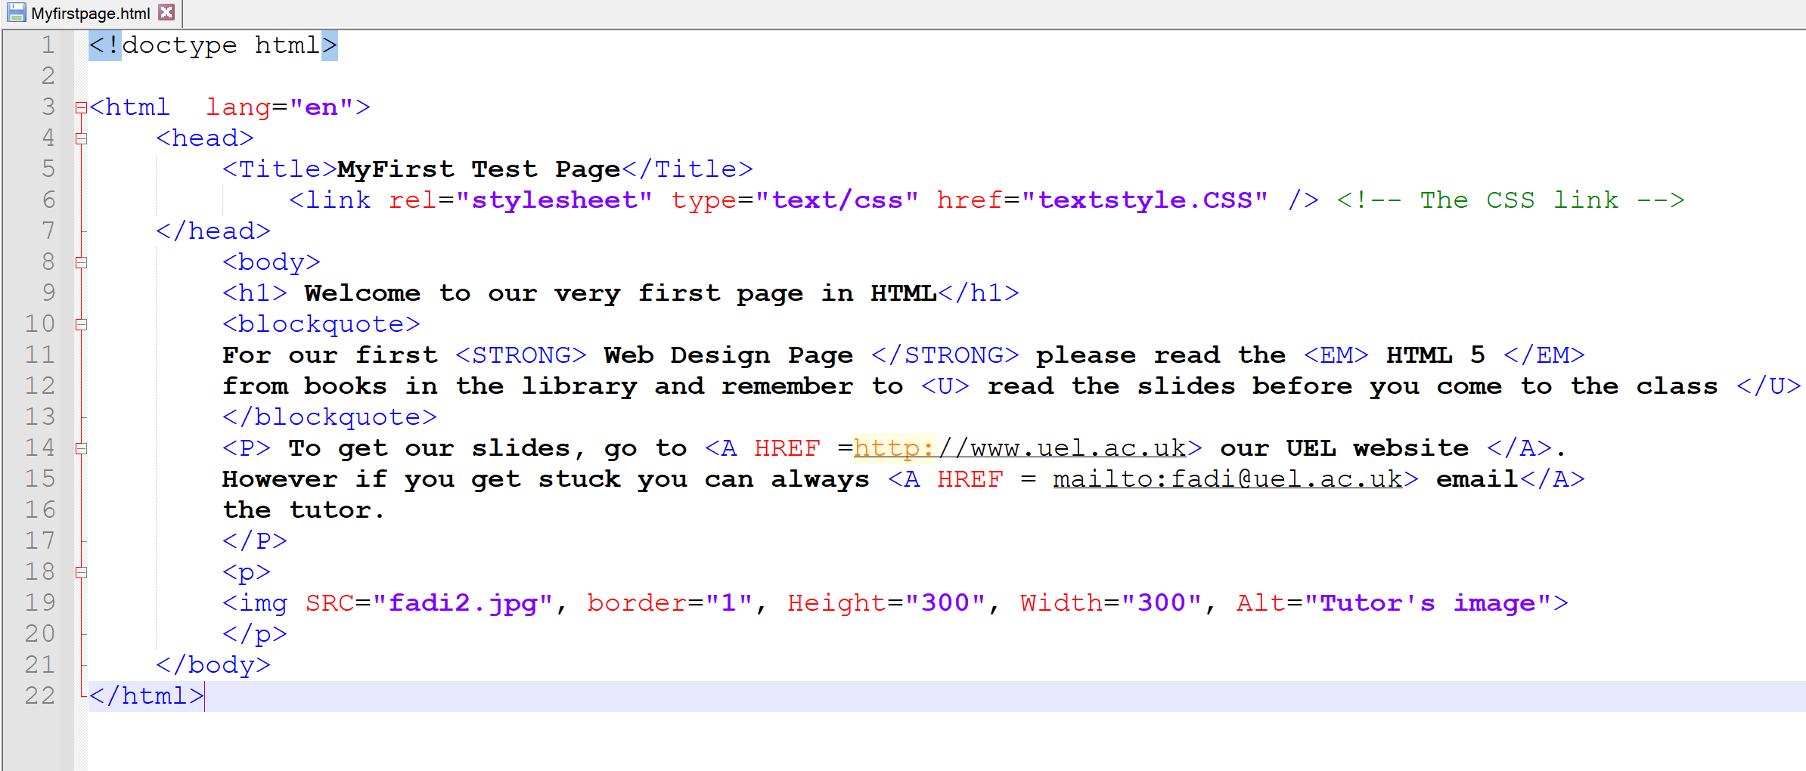
48

Slide 49
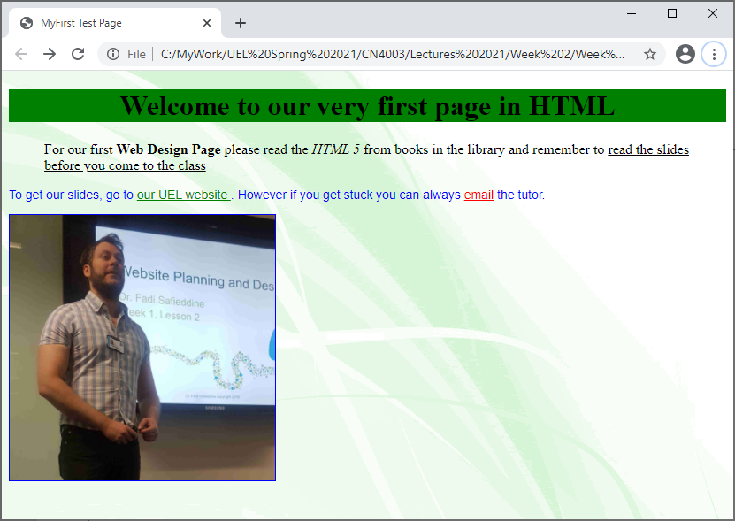
49

Slide 50
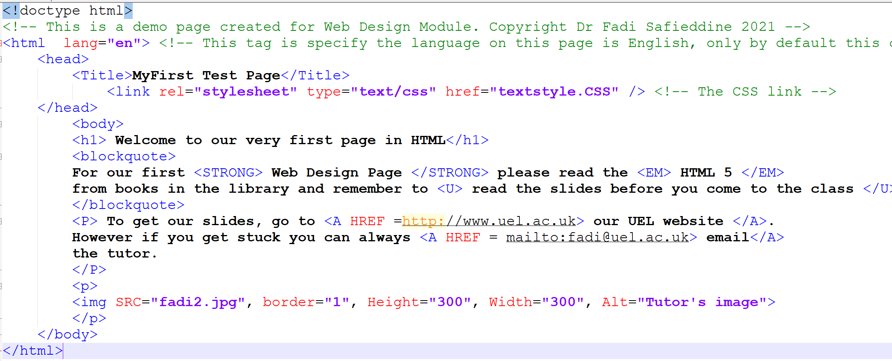
Adding Comments to an HTML page
How much difference does adding comments?
50

Slide 51
Adding comments to an CSS page
How much difference does adding comments?
51

Slide 52
End of Part 5
Activity 2.5. What are the three ways to connect a CSS file to page? Which one is recommended for us to use?

Slide 53
Lab Task and submission
Part 6
Open the demo from the lecture today.
Change the title, content, and format.
Change the image and replace it with your image.
Find a different background and replace it.
Edit the CSS file by changing the colours and styles.
Save the work on the folder.

Slide 54
Further Reading:
Web sources:
CSS Backgrounds:
http://www.w3schools.com/cssref/pr_background-attachment.asp
Different types of CSS & Fonts:
http://www.w3schools.com/css/css_howto.asp
Hyperlinks:
http://www.w3schools.com/css/css_link.asp
Absolutely essential you read the slides and practice creating CSS file and linking the file to HTML before next week’s lecture.
Your personal homework:
Read the slides and create your first HTML page at home.
Open the page from your browser.
If you have problems, show the work next week to your tutor
54

Slide 55

Are you writing valid HTML/CSS3?
You can check code for syntax errors online
Why?
Passing the check means there would be consistency in the display by different browsers.
W3C XHTML Tool
http://validator.w3.org
Later stageHTML5 Tool
http://html5.validator.nu
55

Slide 56


Some fun jokes that now you will get!

Slide 57

Q&A
57

